Slide 1


Coaches Meetings
AAA Baseball and 89ers Softball
Saturday March 2, 2019

Slide 2

Agenda
Sign In
Introductions
NLLL Philosophy and The Importance of Our Culture
Getting Started
  Volunteers
  Forms and Administration
  Practice Planning
Rules and Game Operations
League Functions
  Umpire Training
  Fields
  Scheduling
  Safety
  Fundraising
  Little League Day at T-Mobile Park
  Concessions
Equipment
Notes:
Speaker: Corey

Slide 3
NLLL Coaching Philosophy and our Golden Rules
Little League Parent/Volunteer Pledge
I will teach all children to play fair and do their best.
I will positively support all managers, coaches and players.
I will respect the decisions of the umpires.
I will praise a good effort despite the outcome of the game.
The NLLL Coaching Mission Statement (new for 2019):
"The standard of performance and expectation for North Lake Little League managers and assistant coaches is to consistently display an exemplary level of respect and concern for the welfare, development, and positive experience of ALL player, coach, volunteer, and parent members of the North Lake community.”
Conveying to all adults (fellow coaches and parents) that our sole purpose is to build the skills and support the development of ALL kids on the field and throughout the league.
BE POSITIVE!!! Learn to expunge “Don’t do that / Why did you do that? / That’s not right” from your vocabulary
Psychology tells us it’s a FACT that negative imagery and words are 90% more likely to stick in the brain than positive--therefore when teaching skills don’t emphasize the wrong way.
Three positive comments for every Critique; Five for every disciplinary action
Providing them with a positive role model at all times
Preparing them physically and mentally to compete effectively, fairly and safely in sports
Bringing a level of true and deep concern for the health and welfare of ALL the kids
Teaching the players to interact and support each other as part of a team, and to treat their opponents with the same respect
Providing them the opportunity to play all positions to enable them to learn the sport (especially in the younger divisions)
Remembering that children mature, physically and emotionally at different rates. Their ability can change from one month to the next
Remember they are children not young adults
Notes:
Speaker: Corey and Rich

Slide 4
NLLL Culture Quiz
15 or more points: You are a Culture Leader Coach – Thank you!!
8 to 14 Points: You represent NLLL’s values with integrity
3 to 7 Points: You have a good start – keep reminding yourself and your team
2 Points or Less: Danger Will Robinson!!!
In your most recent season of coaching how many times did you follow the “3 for 1” rule? Three positive comments for every Critique (+5 Points for each occasion)
How many times did you make a choice regarding strategy in the interest of player development (player positioning, hitting lineup, “letting a questionable call go”) reasonably expecting that it may affect your team’s ability to win the game? (+3 Points for each occasion)
How many times did you yell a critical comment or a question to an umpire without first asking for time out to discuss it quietly and calmly? (-2 points for each 0ccasion)
How many times did you use a word, phrase, or expression in the presence of players that you would be embarrassed to describe to your mother? (-3 points for each occasion)
How many times did you demonstrate frustration with a piece of equipment (throwing a hat, kicking something, etc.) ? (-5 points for each occasion)
Has another coach or parent approached you about needing to “tone it down” or “back off” (-5 points for each occasion)
How many times did you invoke the “7 second rule” before speaking to a player, official, or coach about a frustrating event? (+3 points for each occasion)
Notes:
Speaker: Corey and Rich

Slide 5
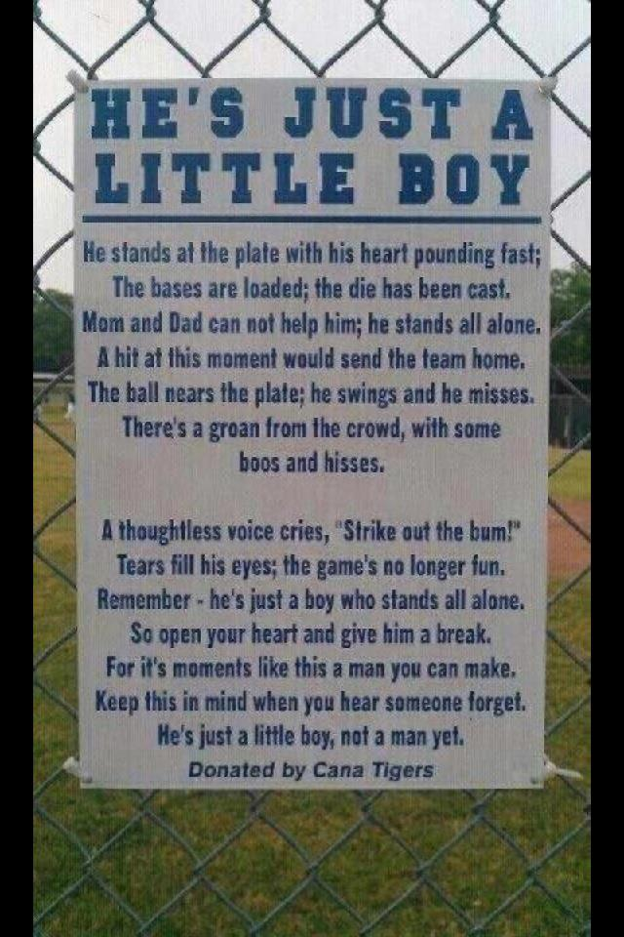
Why our culture and how we operate is paramount…
April 23, 2018 e-mail from NLLL President: “Crisis in OUR league”
April 24, 2018 e-mail from NLLL Coaches Coordinator: “Early Season Reminders -- Those both Mundane and Profound”
KALL 2012 – “YouTube video, incident leads to division in Kirkland American Little League community”
BJFA 2014 Part 1 -- "2 youth football teams banned from playoffs after parents brawl"
BJFA 2014, Part 2 -- "Bothell parents charged with assault in fight at junior football game“
BJFA 2014, Part 3 -- Mom involved in football brawl: 'I wasn't equipped to handle this'
Notes:
Speaker: Corey and Rich

Slide 6

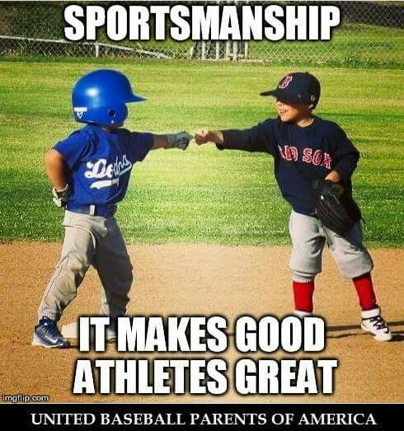

Double-Goal Coach®: Coaching for Winning and Life Lessons
Required – training from a nationally accredited course
Notes:
Speaker: Corey

Slide 7
So you’re going to coach a team…
Role model, leader, expert, official, educator, negotiator, coordinator, planner, accountant, procurement, cheerleader, psychologist, motivator…
You can’t do it all yourself, demand participation: “It Takes a Village to Run a Team” – All families should have at least one responsibility for the season
North Lake Little League is a 100% volunteer organization and we need parents to actively participate
  All Assistant Coaches need to complete a Coach Registration on the league website--Umpires will have a registration as well
  Let them know that this can be a fun family activity if they participate on the field at practice
  Happy to support you at your parents meeting
Develop your skills as a coach so you grow as your child moves through the levels
Notes:
Speaker: Corey

Slide 8
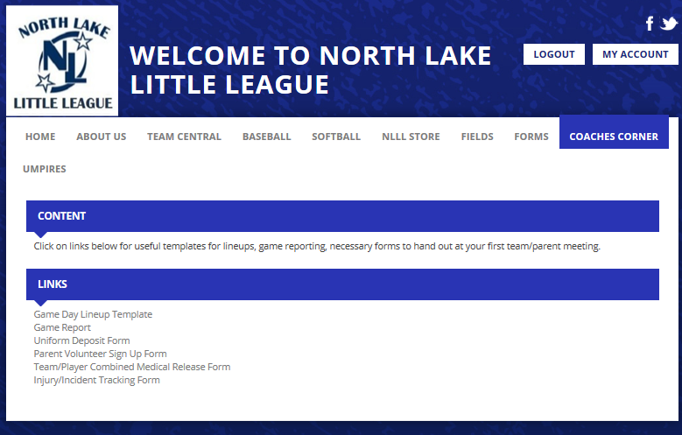
Forms
www.northlakell.org (Log In > Main Page
Required Forms for Parents (NLLL Forms)
  Medical Release Form (PDF or .doc)
  Concussion Information Form
  Parent Code of Conduct (Grandparents, Aunts/Uncles, Friends)
  Volunteer Application (if needed)
Injury Tracking Form (print several and keep with you)
Notes:
Speaker: Corey

Slide 9
Starting the season
Parents’ Meeting
  Set Expectations
  Involve every parent
  Checklist of required forms etc.
  Happy to support you at your parents meeting
  Volunteers, Volunteers, Volunteers – make a sign-up sheet for all of the volunteer jobs and take to the meeting
Coaches Meeting
  Plan a separate meeting (coffee) with your staff
  Get in sync on what, and how, you will be doing during the season
Communication Plan
  Weekly update e-mail
  Group SMS and/or e-mail list to communicate last minute changes (due to rainouts, etc.)
Notes:
Speaker: Corey

Slide 10
Practices
Focus on the basic techniques early in season: 1) Throwing 2) Catching 3) Hitting
Have a practice plan!
  Doesn’t have to be elaborate, rigid, or complicated
  Share with assistants BEFORE practice so that they know how they can help you in setting up drills to save time in transition.
  Sample practice plans available on the web or through NLLL
Demand on-time arrival; end on-time
  Arrive before with time to get ready.
  Idea: ”early bonus” wiffle ball hitting incents players and parents to show up early
  Start practice on time with the players who are there: Late arrivers need to warm up on their own before they can join
Minimize chaos and wasted time by managing the spacing of the kids
  Use cones or carpet “bases”
Set game expectations for how you play by how you practice
  Routine
  Drills vs skills
Notes:
Speaker: Corey

Slide 11
Hitting Cage Sessions
Juniors BB, Majors / Minors SB and BB
Preseason 3 Sessions (max 1 at Rijo)
89ers SB, AAA BB
Preseason 2 Sessions (max 1 at Rijo)
Sluggers/Rookies / T-Ball/Farm Softball
(2) Sessions available if requested (max 1 at Rijo)
In-season allotment TBD
In-season allotment TBD
Northshore Sports Complex
  14220 NE 193rd Place
  Woodinville, WA 98072
  (425) 485-3238
  nsc9@frontier.com
Tom’s Barn (Sunday mornings until 3/31)
  24211 47th Ave SE
  Woodinville, WA 98072
  Contact: NLLL President
Rijo Athletics
  22620 State Route 9 SE
  Woodinville, WA 98072
  (425) 486-4878
Notes:
Speaker: Corey

Slide 12






Resources
www.northlakell.org
NLLL Board and Coaches
  Players Agent is there to resolve parent/player issues
  Coaches Coordinator, VPs, and President can consult on game play questions
https://www.littleleague.org/play-little-league/tee-ball/
https://www.littleleague.org/play-little-league/coach-pitch/
http://www.littleleagueconnect.org
http://www.gamechanger.io
Big Al Baseball: www.bigalbaseball.com
Notes:
Speaker: Corey

Slide 13
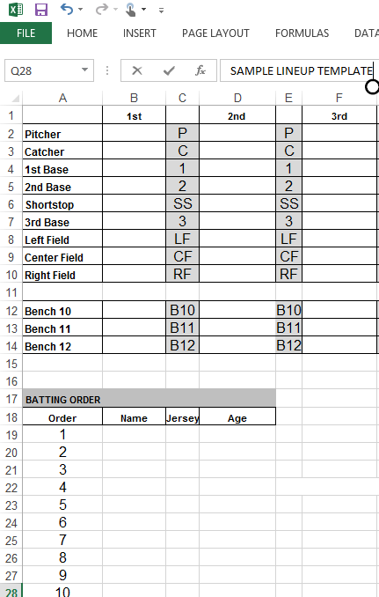
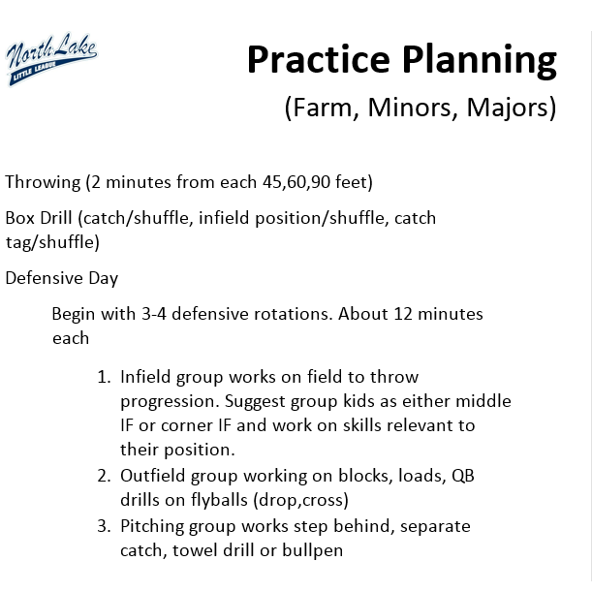
Coaches Corner: Planning Tools
Sample Lineup Templates
Practice Plan Guide
Notes:
Speaker: Corey

Slide 14
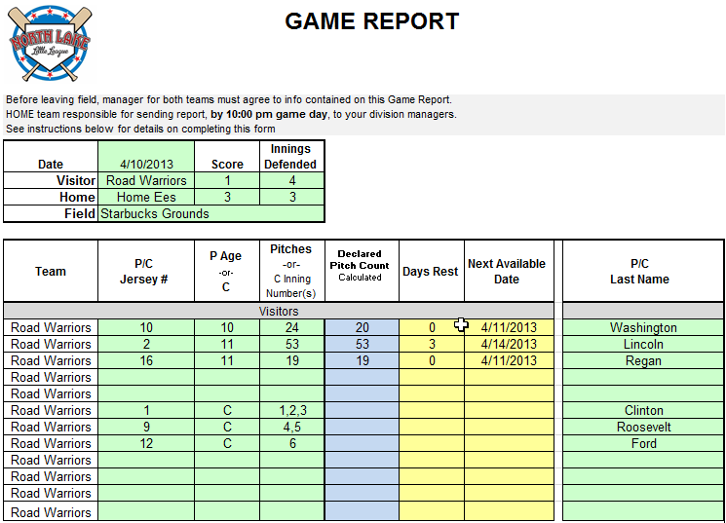
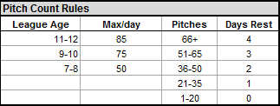
Game Report Demo
A Game Report must be completed after each Majors, Minors, and AAA game, and distributed via email by the HOME manager to the other managers in your division.
Scorekeepers and Pitch Counters confer between innings and immediately after game
In interleague play for Minors and Majors we use a Google Docs file shared between the leagues
We may be going to pitch tracking via our new website in 2019 – Stay Tuned
Notes:
Speaker: Paul

Slide 15
Rules and Game Play Notes for All Softball Divisions
THESE NOTES APPLY AT ALL LEVELS OF SOFTBALL:
  Softball is co-league run through the district softball VPs in the North End.
  Softball umpires NEED TO GO to the league/district umpire clinics.
  Softball rules are sent out by the Softball VP and also posted on our website.
  There will be a softball managers meeting – generally held around the 15th of March (check with the softball VP to see if the date/time is known)
  During this meeting we will sit down with each of the divisions and walk through the supplemental rules for that division and answer questions
  Pitch counts are not a thing in softball and there is no game report except in the TOC.
  Pitching restrictions are by inning.
  Regardless of the minimum play times specified in the district rules, North Lake expects coaches to do their best to offer equal playing time during the regular season
  We do not keep a record of wins/losses during the regular season
  TOC seeding for Juniors/Majors/Minors is by RANDOM DRAW
Notes:
Speaker: Brett

Slide 16
Rules and Game Play Notes for 89ers Softball
POINTS OF EMPHASIS SPECIFIC TO 89ers SOFTBALL:
  There is no stealing at this level
  2 innings of coach pitch followed by 4 innings of kid pitch
  No ToC, coaches rank teams based on discussion and teams are paired up to play a final competitive game.
Notes:
Speaker: Brett

Slide 17
Sportsmanship Notes – AAA Baseball
Remember:
  This is an instructional league. Yes, we keep score, and have winners, but the goal of this division is to have fun, and prepare kids for the next level. ALL players should get game play at Pitcher and Catcher
Scoring
  If/when the score is out of hand, (8‐10 runs), do not continue to run up the score by taking extra bases, stealing etc. If you are entering a game against a less skilled team or you find yourself with a large lead use the opportunity to get less experienced pitchers into the game.
“Dancing to entice a throw”
  Runners attempting to advance an extra base by drawing a throw to a base already acquired while the ball is in the control of an infielder is not in line with respecting the game and is not considered a “normal” play in baseball. This is STRONGLY discouraged and should be discussed during pregame plate meeting.
The Strike Zone ‘Is What It Is’
  Most umpires are consistent with their zone for both teams. A truly good coach will help his team to adapt, not complain about the zone. Harping on umpires over balls and strikes is STRICTLY FORBIDDEN and we have a Zero Tolerance policy
Notes:
Speaker: Brett

Slide 18
Supplemental Rules – AAA Baseball
Print, read, and understand 2019 NLLL Supplemental Rules
Time Limit and Curfew: No new inning may start after 2 hours (2 hrs. 15 mins. in playoffs). However, if the result would be a tie game (see LLOR 4.10-4.12), there is sufficient light, and the field is available, then the game may be continued. Games shall not extend beyond 2 hours 30 minutes even if no game scheduled behind. No inning shall start after 8:15 on a non-lighted field.
After 4 balls thrown by kid pitcher coaches pitch from the front of the portable mound (standing or kneeling). i.e., approx. 40 feet.
When coach pitcher is on the field the kid pitcher should be positioned at distance < 4 feet behind the rubber and 3 to 6 feet offset from the mound. Either side is fine.
In general we should always look to reward the defense when a play is close or in question.
Intent of Pitcher Control : “Any runner who has attained a base, but is no longer advancing, or has returned back to the attained base, may not advance on an errant throw back to the pitcher—the play shall be considered over”
Stealing – difference between
  1st to 2nd – must be a passed ball behind the catcher
  2nd to 3rd – open stealing but no advance on throw back to pitcher
1 base per overthrow on a batted ball
  No advance on catcher overthrowing to 2nd or 3rd for a steal. Promote attempting to throw runners out
Notes:
Speaker: Brett

Slide 19
Supplemental Rules – AAA (Cont’d)
5 run limit in all innings except for the last inning – hit through the order instead
  Agree on time concept at plate meeting
  Agree on last inning at the start of that inning
Most commonly overlooked/misunderstood rules
    Pitch limits, especially over multiple games.
      No pitcher, regardless of pitch count, shall pitch more than six (6) defensive outs.
      40 actual pitches max for a pitcher going to catcher
      Players may not return to pitch after vacating the pitcher position for another defensive position (including bench).
    Minimum playing requirements for all players
    5 run limit / No 10 run mercy rule
    Managers or coaches must not warm up a pitcher at home plate or in the bullpen or elsewhere at any time. Only players wearing a mask can warm up pitchers
Notes:
Speaker: Brett

Slide 20
Supplemental Rules – AAA Baseball
Minimum Play Requirements
 | North Lake Little League | Little League International “Green Book”
Total Defensive Outs Played | 12* | 6
Defensive Outs in Infield | 6** | n/a
Consecutive Innings Resting | <=1 | n/a
*Note: If a player does not meet minimum play requirements due to a game finishing before 6 innings then that player shall start in the next game and complete the uncompleted requirement. **New for 2019: Minimum infield play time must be met by the end of the 4th inning
Notes:
Speaker: Brett

Slide 21
Umpires – Rich Fried umpire@northlakell.org
Read the Green Book (app available for ios/android platforms)
Supplemental Rules and umpiring tips for each division available on website. North Lake Umpires/Rules page
2019 NLLL Supplemental Rules
Rule Changes
Bat Information
  bats can be checked here:
  http://www.littleleague.org/learn/equipment/baseballbatinfo.htm
Equipment and handout
Training Available
Dist. 8 Rules Clinics:
  Sessions 1a and 1b – February 26 and 28th from 6:10 pm to 8:.30 pm Bothell High School Library
  Sessions 2a and 2b - March 12th and 14th from 6:10 pm to 8:.30 pm Shorewood High School
Dist. 8 Field Mechanics:
  Session 1: Saturday March 2nd from 9:00 am to Noon at Northshore Athletic Fields (NAF)
  Session 2: - Saturday March 16th from 9:00 am to Noon at Shorewood High School
NLLL Mechanics Clinic (mandatory)
  Sunday March 10 12:00 pm to 3:00 pm Northcreek #4
Notes:
Speaker: Brett

Slide 22
VOLUNTEER UMPIRES -
The Game does not happen without them
1. Preferably recruit/secure 3 volunteers. (Juniors, Majors, Minors, AAA Baseball, Sluggers Baseball and 89ers Softball)
  a. Parents, Grandparents, Brothers, Sisters etc.
  2. Each Team Provides 1 umpire for each game.
  a. Home team – plate ump (except Sluggers)
  b. Visit0r – field ump
  3. NLLL provides all necessary gear and training.
  TELL THE PARENTS TO GET INVOLVED-OUR KIDS NEED UMPIRES SO THEY CAN PLAY THE GAME.

Slide 23
Field Prep – Mark Madigan markio506@gmail.com
Bastyr Field Prep Training and Setup Day: Saturday March 9th 9:00am to 3:00pm—Every team must send at least one parent
Field prep is EVERY team’s responsibility
Assign parents to do pre and post game prep
The HOME team is responsible to prepare the infield for safe play to the satisfaction of the umpire
If you are the last practice or game of the day:
  Close down the field (which includes dragging the field if at Bastyr)
  Make sure that the bases are put away and the base caps are put back in the pegs, and covered with (sand)
VISITOR team is responsible for tear down
Both teams: clean up all garbage

Slide 24
Field Prep Do’s and Don’ts
Do not leave a field at Bastyr without dragging it, ever! Never leave the field “used”, rain will puddle on an unraked field but a smooth field can tolerate an overnight “Seattle rain” and be ready the next day.
Don’t use a broom to disperse puddles
Don’t sweep a puddle into the grass
Don’t drag on the grass
Don’t throw or hit balls against the fences
Do use a pump or puddle pillow to remove standing water
Do remove bases & replace base caps before dragging
Do fill holes and low areas
Notes:
Speaker: Paul

Slide 25

Important Numbers
Field | Phone
Northshore School District Fields | 425-408-6020
Forsgren and Logan Park (decision made by 3 pm) | 425-388-6030
City of Bothell (Moorlands, North Creek, Doug Allen, and Cedar Grove) | 425-806-6102
Northshore Athletic Fields (NAF) | 425-486-7333
Bastyr | Coaches' decision
Bastyr Security (to open gate) | 206-850-1710
Field | Combo
Bastyr | 4438
Arrowhead | 4438
Moorlands Park | To be confirmed
Forsgren Park | 6829
Chain lock for mounds at North Creek | NLLL-6829 NSLL-8787
Brier Park | 4438
Logan Park | 2013
NSD Gates with keys inside | NSD

Slide 26
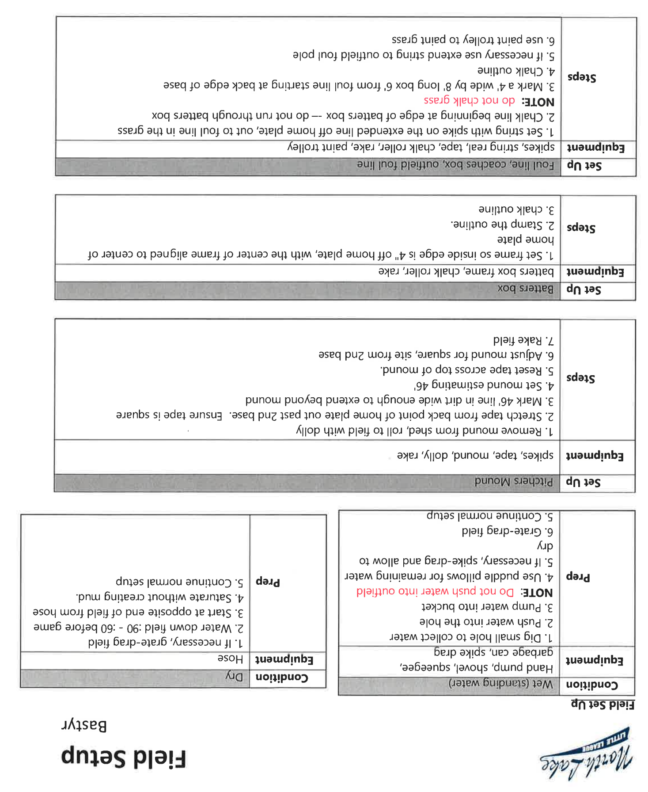
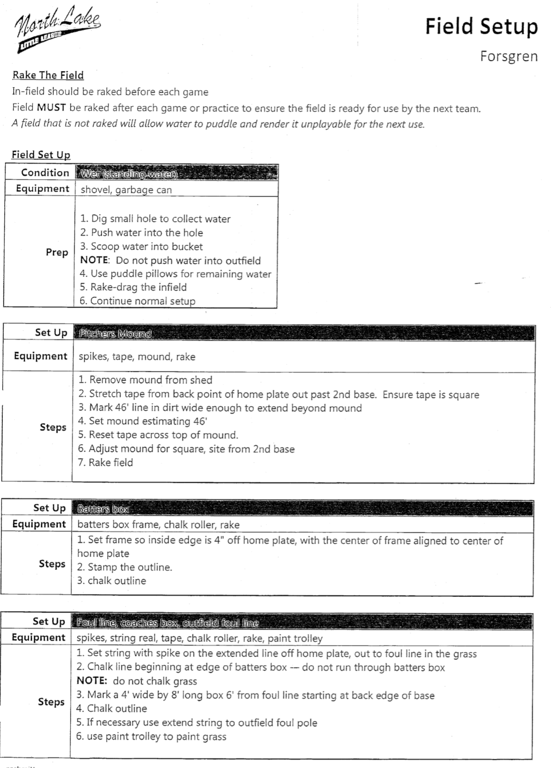
Field Setup—Bastyr and Forsgren

Slide 27
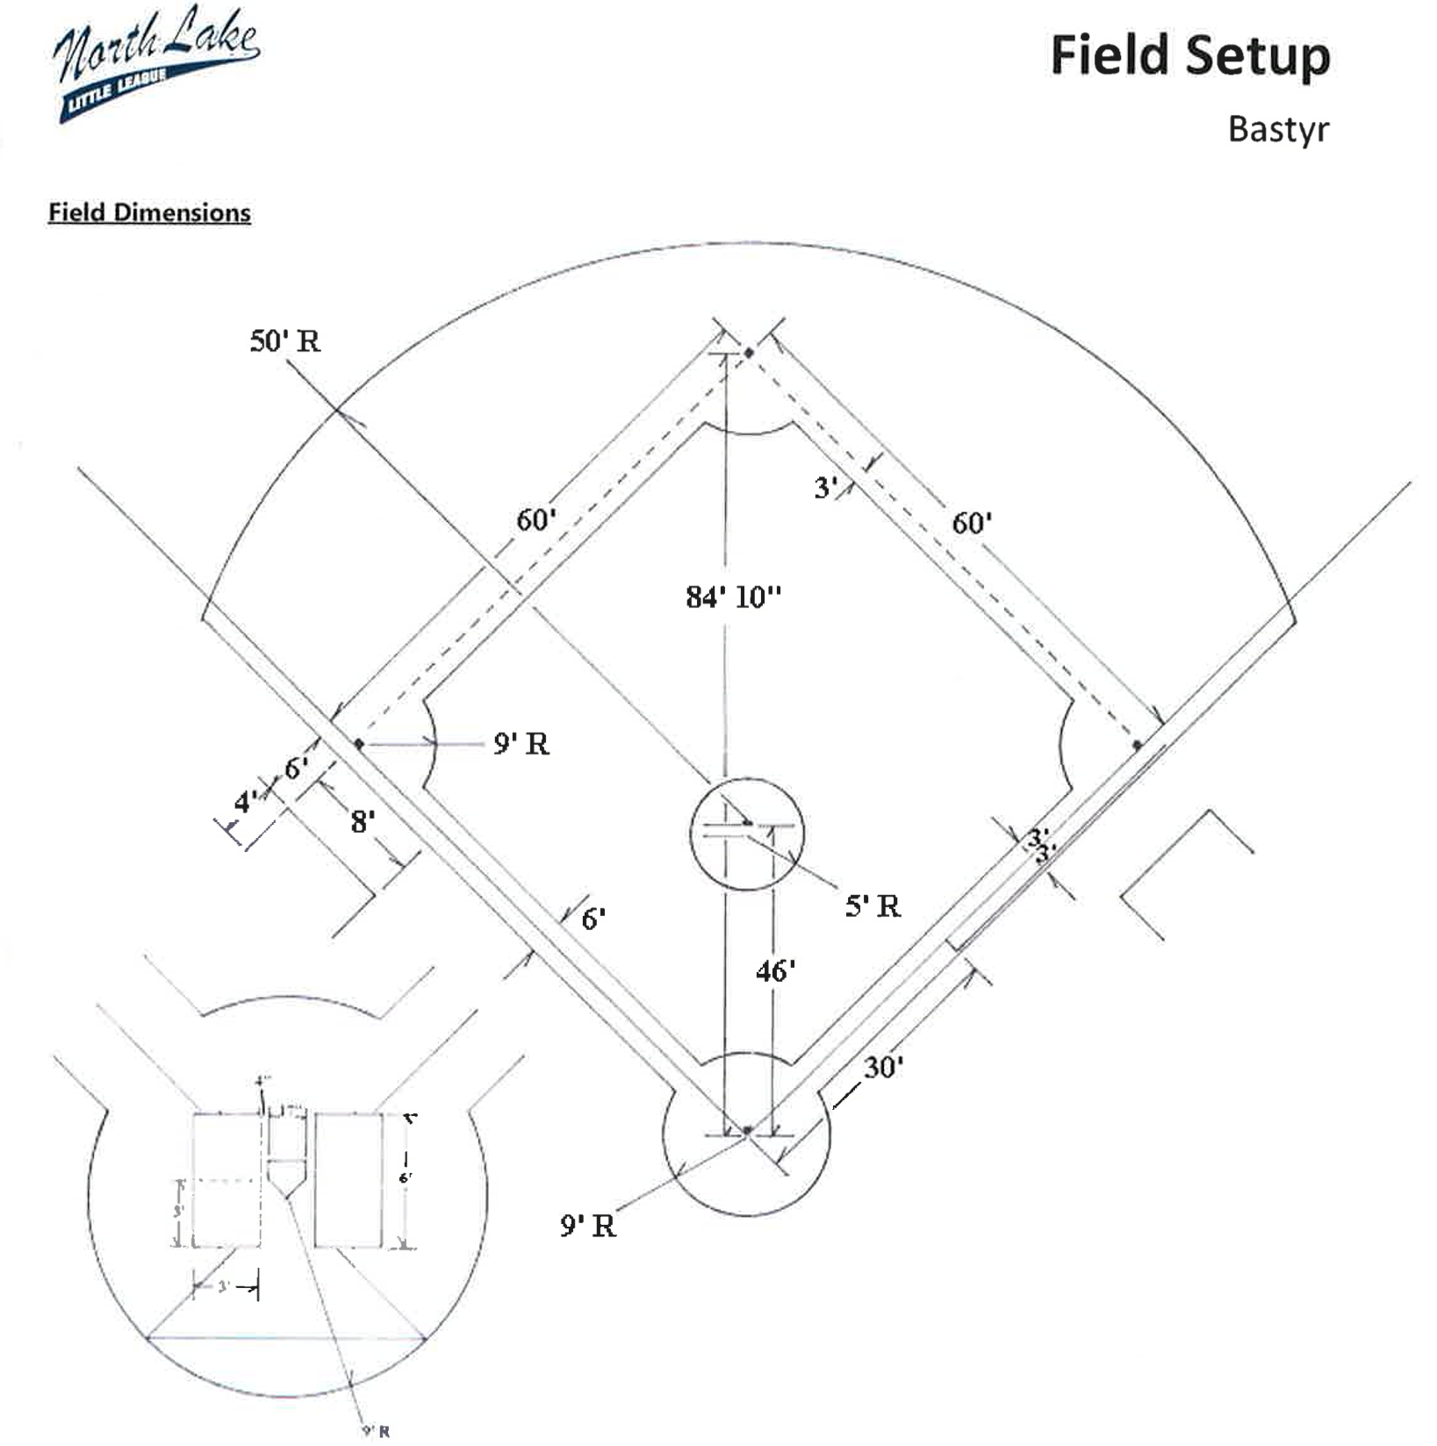
Field Prep
Cocoa matt drag the field before every game, pick up rocks
Rake and prep the batter’s box – fill in the “footprints”
Set batter’s box (3’x6’) with chalk (tip: rakes are 3’ wide)
Measure and set field dimensions
  Mound: 46’ from front of rubber to back tip of Home plate
  Bases: 60’ from base to base and 84’ 10” from Home plate to 2nd Base
Use the twine to set a chalk-line from home to 1st & 3rd
Be prudent with the use of chalk: no chalk in grass or decorative drawing
Set cones (if no fence): 200’ for Majors, 180’ for Minors, 150’ for Farm and below
Cocoa matt drag the field after every practice or game
Never leave the field “used”, rain will puddle on an unraked field

Slide 28
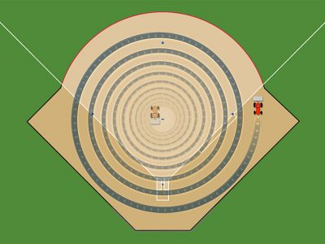
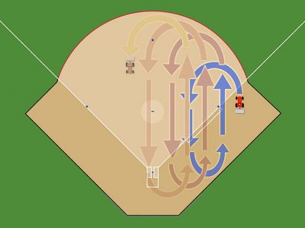
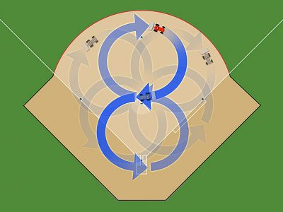
Post-Game Mat Drag
(Bastyr)
Choose a different pattern than you did last time
Start at the day position
  M/W/F: 1st base
  Other: 3rd base
Water prior to games and practices more deeply than just to settle dust, then have players pick up rocks—it goes very quickly!
After last game for the night, cocoa mat one of those patterns below
Circles, outside → in
Overlapping Ovals
Figure 8
NEVER INSIDE → OUT

Slide 29
Scheduling – Mandie Neher
scheduler@northlakell.org
2019 NLLL team count: 50 (6 more than 2016)
If you are granted a field (especially turf) and it is NOT rained out by the field owner and you cancel the practice/game due to rain and not because of a true safety problem…..then…..
Field scheduling is extremely complex. Be:
  Flexible
  Nice
  Reasonable
  Patient
Scheduler requires quick responses to set a plan in motion
Mother Nature can be everyone’s enemy
Field access is often out of league’s control
Make-up Games/Practices
  Use your normal practice time/location as the first choice for a make-up game.
Notes:
Speaker: Corey

Slide 30
Safety – Debbie Hogge sdhogge1@gmail.com
Safety Forms
  Online at northlakell.org
  Medical Releases
  Injury Tracking Form
  Emergency Contact Form
First Aid Kit
  Contents
  Replenish
Training
  Today’s training
  March 2nd if needed
3 Instant Ice Packs 2 Plastic Bags for Ice 6 Antiseptic Wipes 2 Large Bandages 2” x 4” 2 Large Non-stick Bandages 20 Band Aids 1” x 3” 2 Antiseptic Cream Packs 1 Roll 2” Sports tape 2 Eye Pads 1 Roll of Gauze 2 Burn Cream Packs 1 Pair of Latex Gloves 1 Pair of Tweezers 2 Sterile Gauze Pads
Notes:
Speaker: Kevin

Slide 31
Safety
You are responsible for each player from the time they are dropped off until their parent picks them up, or somebody designated by their parent. Players are NOT to be left alone. Make sure kids don’t wander into the woods at Bastyr before or after practice.
Incident Forms: www.northlakell.org
Ice! Assign a parent to bring (real !!) ice to every practice and game
Note: needs to be someone dependable
Batting Cages – bats down!
Throwing – don’t walk between the lines
Curb uncontrolled throwing or hitting or horseplay – No Flyers’ Up
Someone will get a ball in the face at the first practice
  Be prepared, be calm
Notes:
Speaker: Kevin

Slide 32
Safety
Injuries
  Always notify parent
  Severe: call 911
  Managers carry Medical Releases
Treatment
  Cuts & scrapes
    Clean, dress, no blood on uniform
  Bumps
    Ice
  Concussion
    Lystedt Law
Fields
  Inspect prior to game
  Both teams should do a “rock walk” before the game
Equipment
  Inspect before season, all must have current certification
  Cups , no jewelry
Games & Practices
  No bats, except batter
  Players stay in dugout
  Bats down in batting cages
Facilities
  Parents supervise siblings
  Lightning
  No dogs, tobacco, alcohol, or sunflower seeds
Discipline
  Keep control of team – stay safe
  No “uncontrolled play” before or after practice
Notes:
Speaker: Kevin

Slide 33
Fundraising/Sponsorship
Each team must have a designated Fundraising and/or Family Fun Day Coordinator
  League contacts:
    Andrew Holes—Sponsorship: andrew@jwilburfoods.com.
    Get the word out!! We are an all volunteer league!
Family Fun Day
May 18, 2019 Time TBC (likely 10:00am to 4:00pm) @ Bastyr
  Get the word out!! We are an all volunteer league! Family Fun Day provides more than $5000 to the league budget
  Team pictures - $4.50 per player back to NLLL
  Derby and Skills - players collect pledge money
  Silent auction - team theme baskets
  Family carnival All day: games, dunk tanks, etc.... Prizes, food, fun
  Team fundraising packets distribution
  All FFD information/forms will be posted to NLLL website
Sponsorships and Corporate Matching (NLLL is 503(c) )
  We LOVE the small businessperson and can provide relatively inexpensive exposure to 300+ Kenmore/Bothell families
  Corporate Matching Program (e.g. Microsoft, Boeing ) – Umpires, Coaches, Scorekeepers
Notes:
Speaker: Lori

Slide 34
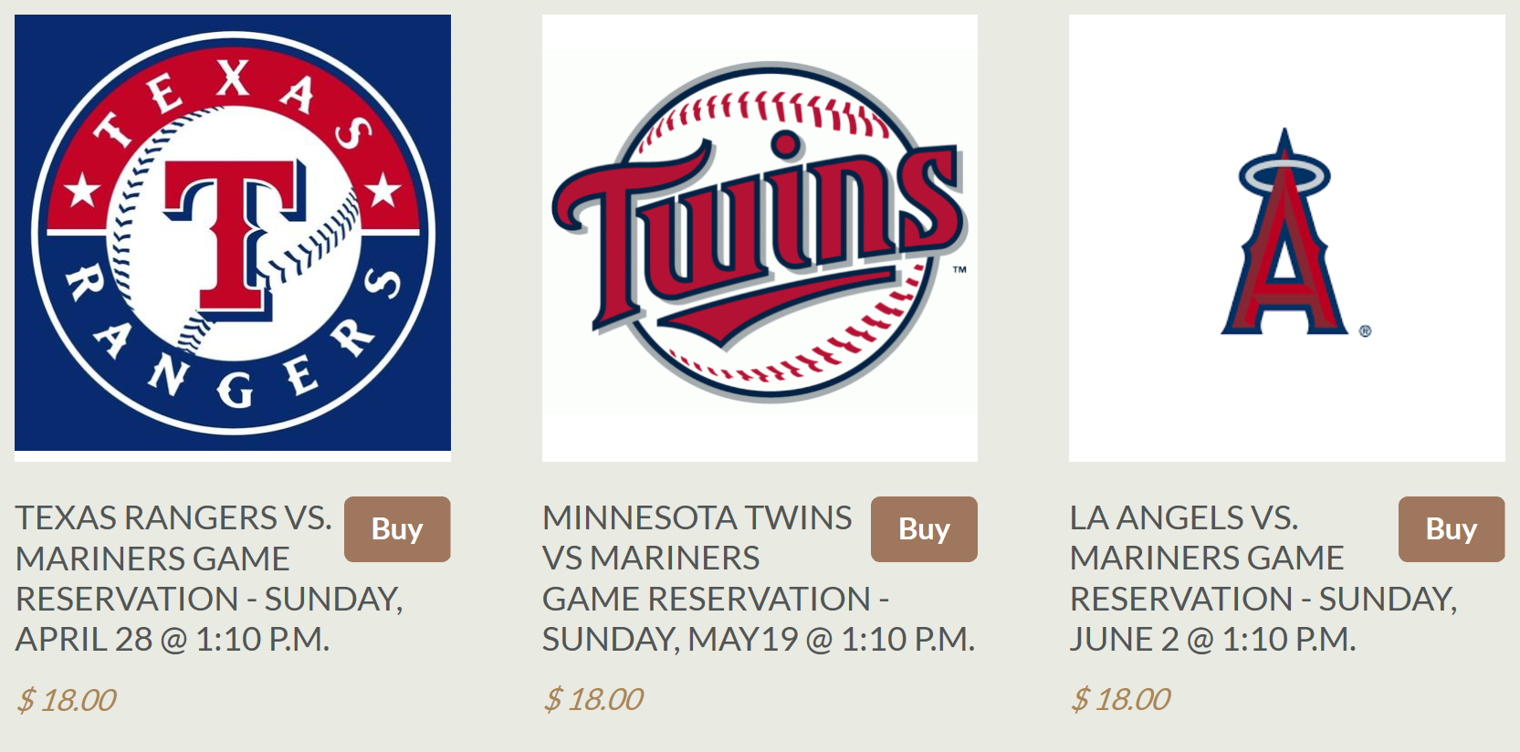
Little League Days at T-Mobile Park!
Game Dates: April 28, May 19, June 2
Choose a Mariner’s Little League Day Coordinator and game to attend by March 18. Parents can order tickets through NLLL for other games, too.
Minors and Majors teams note that ToC games after Memorial Day can conflict with the June 2 date—no refunds
Send the name of your volunteer and the your game choice to Danny Howe by April 1st at baseballvp@northlakell.org
Why the earlier deadlines? Early season Angels game.
Now-April 1: Parents visit http://northlake-little-league-store.myshopify.com to pay and reserve their tickets. They must indicate their team name in the shopping cart.
Once tickets arrive, they will given to M’s Day Coordinators for distribution to each team. They will also be given a spreadsheet with all their team orders.
$3.00 per ticket fundraising fee added for NLLL. $18.00 ticket total
Parade on the Field before the Game 11:10 am to Noon
Notes:
Speaker: Alex or Corey

Slide 35
Concession Stand at Bastyr
Concessions@northlakell.org
Concessions are pending refurbishment of the trailer – stay tuned
NLLL Bastyr Concessions
Brings in several thousand dollars a year
Available during games at Bastyr fields and Family Fun Day
Provides a fun service for NLLL families
In order to increase revenue and provide a more consistent service, we are asking for one parent volunteer from each team to help out during the season. The Team Concessions Parent Volunteer would be helping out only during his/her team’s games at the Bastyr fields.* The coordinator will set up a volunteer schedule to provide each team equal opportunity for participation. A volunteer sign up will be email to each volunteer.
Please submit your team volunteer ‘s name and contact information to Genoveva Marin, NLLL Concessions Coordinator. Thank you!
Team Concessions Parent Volunteer*
Responsibilities
Assign somebody to work the concession trailer (older children are invited to help out)
Open and lock up the concession trailer
Secure money from sales in the black file box for collection by Genoveva Marin, Concessions Coordinator
Concessions “tours” available at Bastyr fields by request. Please email, text, or call to set up a time
Contact Genoveva Marin: Concessions@northlakell.org
(425) 770-3341
Notes:
Speaker: Alex or Corey

Slide 36
Equipment List – Chris Scott
ALL
You do not have to return the balls, but you can if they are in good shape and you won’t coach at the same level next year.
All other hard gear must be returned at end of season
If you need any other gear during the season, I can resupply you (baseballs, equipment, etc.) Send an email to hardgoods@northlakell.org
AAA - equipment bag with 2 bats, 2 doz practice balls (all weather), 1 doz game balls, 1 doz wiffle balls,
pitch counter, scorebook, Tee, throw down bases, catchers gear
Rookies and Sluggers - equipment bag with 2 bats, throw down bases, hitting tee, catchers gear, 2 doz practice balls, 1 doz game balls
T-Ball - equipment bag with 2 bats, throw down bases and hitting tee, 2 doz practice balls-1 doz game balls
Notes:
Sync with Mike

Slide 37
Handouts
First Aid Kits
Green/Orange Books
Your team equipment
Coach’s drill card deck
PCA Book for Managers
T-Ball Coaches Guide

Slide 38
Thank You and…Play Ball!

Slide 39
Text of April 23 and 24, 2018 e-mails
April 23, 2018 e-mail from NLLL President: “Crisis in OUR league”
April 24, 2018 e-mail from NLLL Coaches Coordinator: “Early Season Reminders -- Those both Mundane and Profound”
Notes:
Speaker: Corey and Rich

